Slide 1

UE19CS204 – Web Technologies Mini Project
Project Title - MERN EXPENSE TRACKER
Section - A
A Spoorthi Alva : PES2UG19CS001
Achyut Jagani :PES2UG19CS013
Amulya S Dinesh : PES2UG19CS035
GITHUB Link -https://github.com/achyutjagini/expense-tracker

Slide 2
Abstract
The MERN Expense Tracker application will allow users to keep track of their day-to-day expenses. Users who are signed in to their accounts will be able to add their expense records with details such as expense description, category, amount, and when the given expense was incurred or paid. The application will store these expense records and extract meaningful data patterns to give the user a visual representation of how their expense habits fare as time progresses. The application uses the mongodb database.The application has a homepage and allows users to register.After registering they can add expenses. The keeps track of past expenses and also keeps a report of the expenses.Recent expenses are displayed in the home screen.

Slide 3
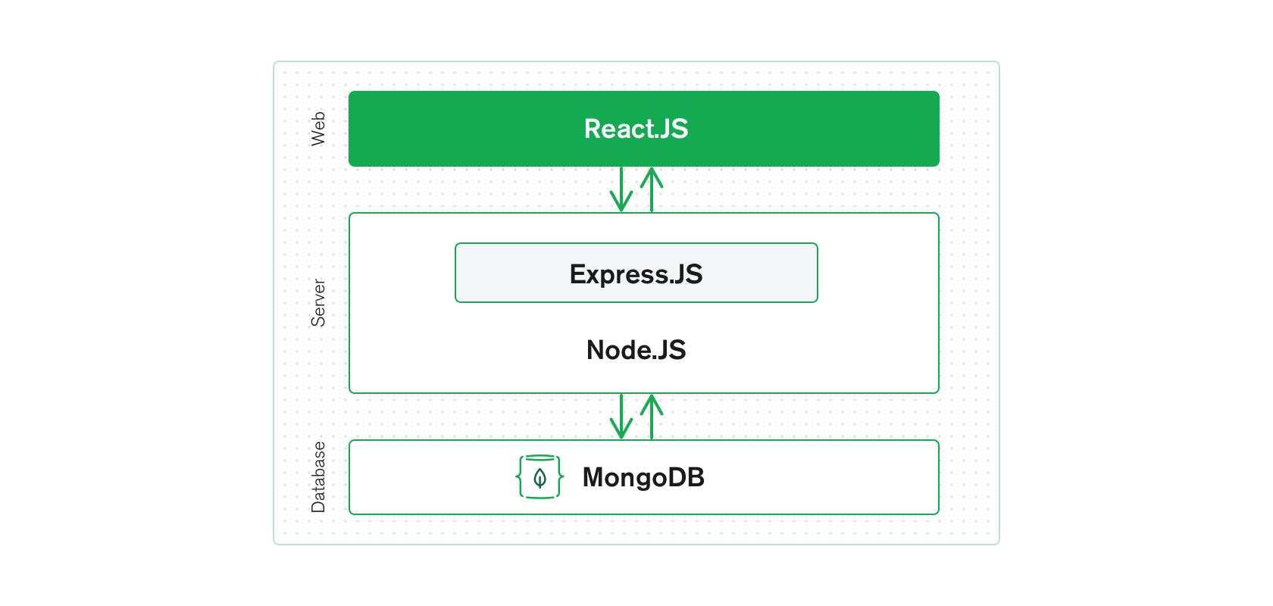
Technologies Used
M-MongoDB
E-ExpressJS
R-ReactJS
N-NodeJS

Slide 4
Victory (module for data visualization)
Nodemon (automatically restarts when changes in file is detected)
hydrate (render)
JWT - JSON web token (authentication mechanism)
mongoose (used to interact with the database)
react-hot-loader (update without re-bundling front end)
cors - cross origin resource sharing (restricts resources on a web page to be requested from another domain)
helmet (used to secure HTTP headers returned by express app)
compression (decreases the downloadable amount of data that's served to users.)
material-ui pickers module (to choose date and time)

Slide 5
webpack (purpose is to bundle JavaScript files for usage in a browser )
webpack-dev-middleware (A development middleware for webpack)
webpack-hot-middleware (ensuring the server bundle used is always the latest compilation without requiring a restart)
UI Core expansion panels
query strings
cryptography
prop types
Material ui

Slide 6
Member Contributions
Achyut Jagini: Front-end (main.js, client_main.js , main_router.js, app.js, report.js, users), Server-end (helpers)
Amulya S Dinesh: Server-end , Front-end(reports)
A Spoorthi Alva: Expense , Models (Database)

Slide 7
THANK YOU!

